Slide 2
Presentation
EBENE Group is the cooperation of 2 companies
NEOS Industries and RI2E.
EBENE Group and its partners propose their know-how
and expertise in different fields: water treatment process
photovoltaic and renewable energy, biogas, automation etc
Thanks to our team of specialists, we operate worldwide.
É
F A C
E
4

Slide 3
Field of application
Navy
Energy
Anaerobic
digestion
Petrochemical
Water
Manufacturing
Industry

Slide 4
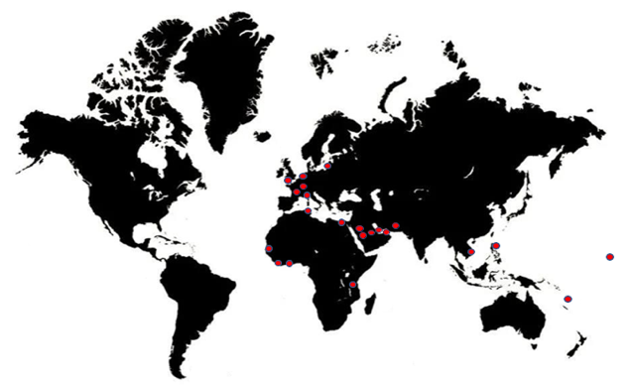
Location
Head office:
Auvergne-Rhône-Alpes, France
30 km East Lyon
150 km South Geneva
Projects worldwide :
Europe
Middle East
Africa
Asia
A local presence with a global reach

Slide 6
Process Water
We answer your questions and needs for all equipments required for your process water.

Slide 7
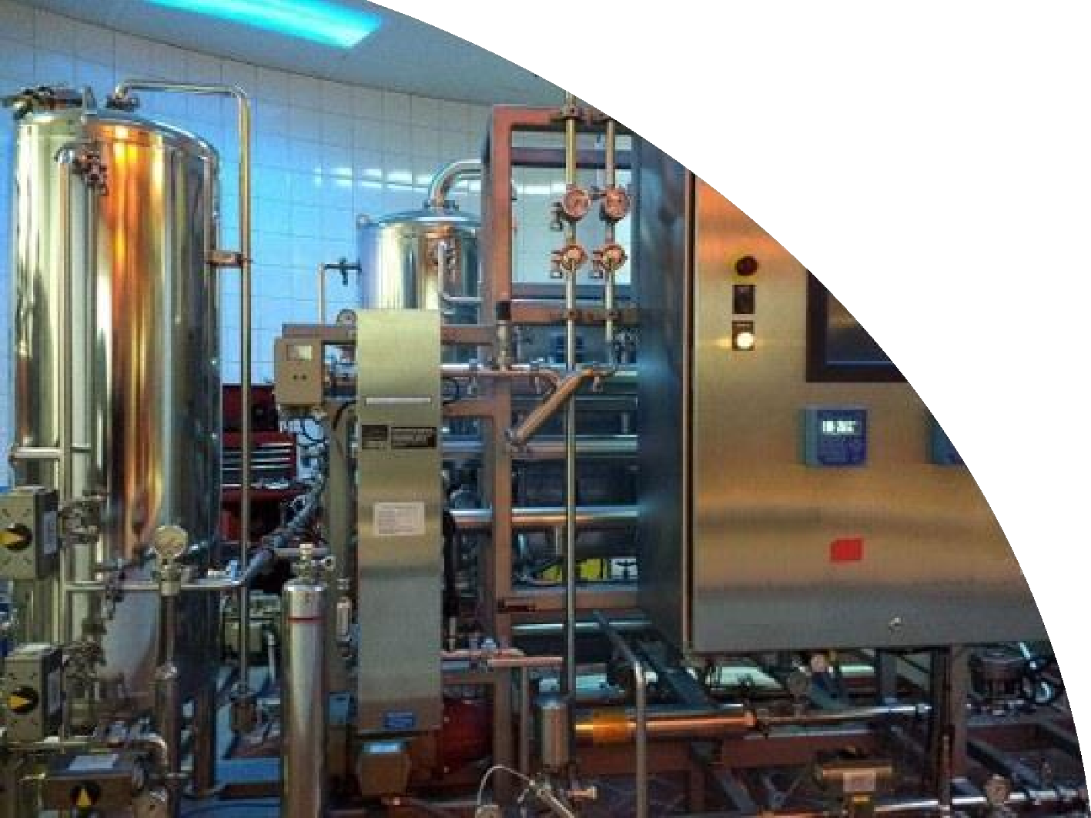
CIP
Effective cleaning of your installations ensures product quality and prevents the risks of contamination as well as the production losses.
We design our CIP units to optimize consumption of water, energy and chemicals.

Slide 8
Drinking Water Treatment
We develop together any solution for drinking water treatment, whatever its source or the complexity of your installations.

Slide 9
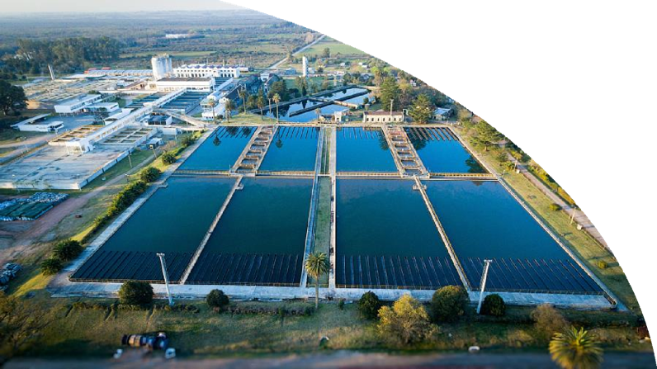
Waste Water Treatment
We guide you through the design, the conception and the supply of all equipments required to comply with your plant’s discharge standards.

Slide 11
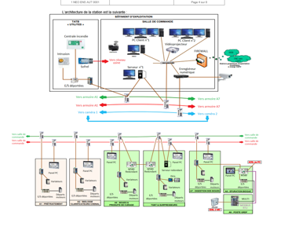
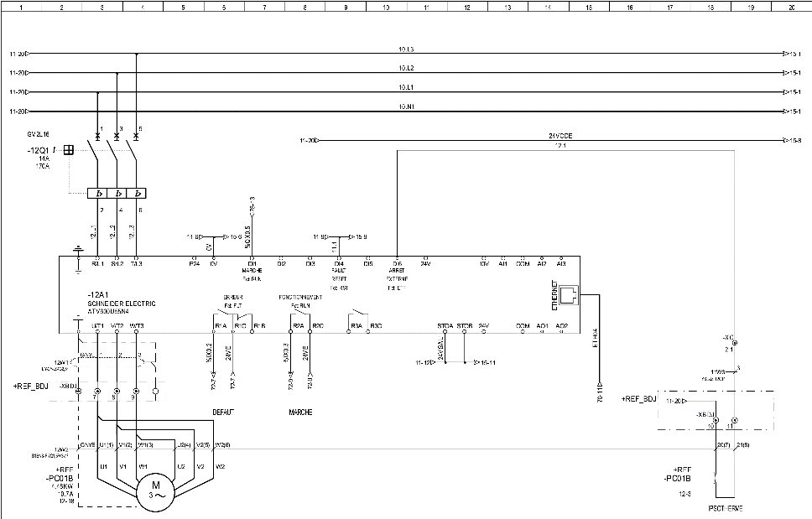
Engineering, Electricity and Automation
We respond to your industrial projects, with or without automation.

Slide 12
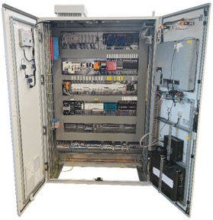
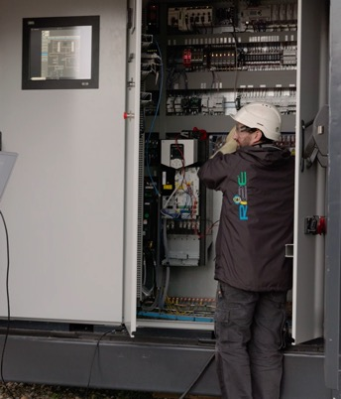
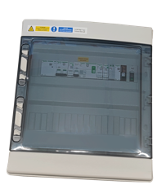
Electrical cabinets
We design electrical cabinets
on request : residential or control cabinets, low voltage electrical panels or any other projects.

Slide 13
Photovoltaics and Renewable Energy
We advise and supply all required equipments for your photovoltaic and renewable energy projects.

Slide 14
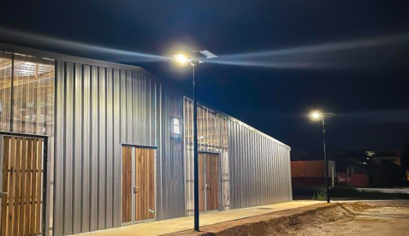
Solar Masts
With our partners of solar masts, we implement innovative light solutions with energy control for your streets, roads and companies . Our solar masts are the ideal solution for lighting with renewable energy sources.

Slide 15
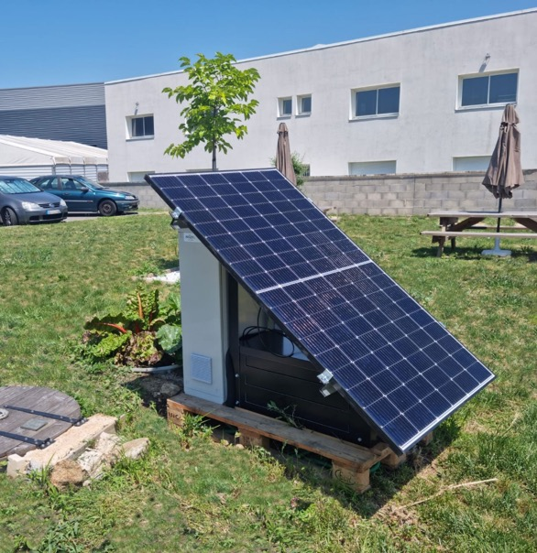
Isolated Site
We build solutions to power supply isolated places of any kind :
- independent electricity grid
- energy storage

Slide 17
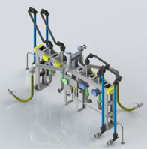
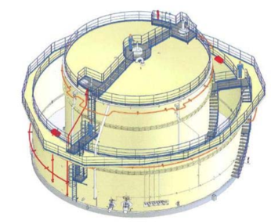
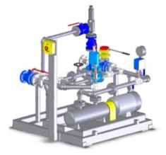
Petrochemical
We assist you for :
Feasibility study, master plan
Detailed project design
Design study
Delegated project management
Execution engineering
Technical assistance

Slide 19
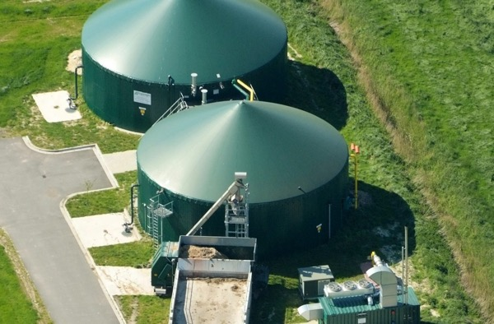
Anaerobic digestion
With our partners we propose you automation and control solutions for gas treatment and energy value enhancement :
- robust
- easy to use
- efficient

Slide 20
Human well-being through quality management and respect for nature and environment

Slide 21
More than a Group : a real know-how
Project Management : Before summary project, detailed project design, technical specification, assistance for subcontractors’ selection
Engineering : Process and instrumentation diagram, hydraulic calculation, instructions, technical solution control
Electrical Studies : Cable size calculation, wiring diagram, material selection, design
Automation : Functional analysis, program, platform tests, commissioning, training
Realization : Assembly, electrical cabinet wiring, sites conception and realization, tests and commissioning
Technical assistance : Aftersales service, helpdesk and technical support
Digitalisation : Production process connection for production optimization and efficiency in energy, raw material and time

Slide 22
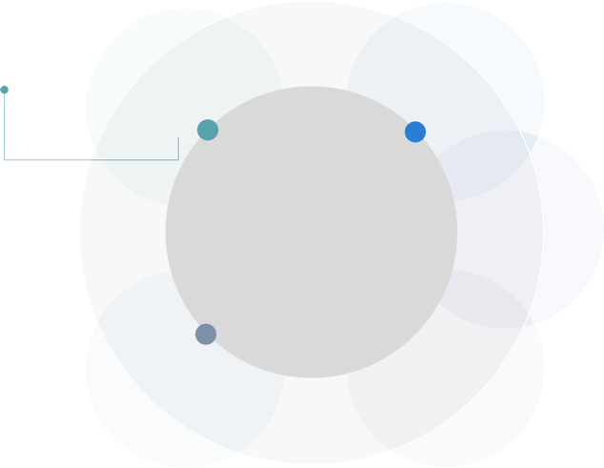
Organisation chart of EBENE Group
Production Workshops
Automation Supervision Engineering
Electrical Design Office
Electrical Engineering
RI2E
NEOS Industries
Bruno PERNA
CEO
Jean-Philippe RIOULT
General Manager
J&G SAS
EBENE MAROC
El Mehdi JAHID
CEO
Project Management Assistance
Riahi BACHIRAT
General Manager
A multicultural team of expert engineers and technicians to propose, develop and implement a variety of industrial projects, often going beyond the customer's initial requirements, for improvement and satisfaction.

Slide 23
They trust us

Slide 24
THANK YOU
EBENE GROUP
c o n ta c t @ ebene-group. f r

